Slide 1
FACE LOG
know your customers…

Slide 2
TABLE OF CONTENTS
Project Definition & Explanation Roles and Responsibilities Existing Systems and Its Limitation Hardware & Software Environment Flowchart & Implementation Snapshots and Data Dictionary Limitations and Future Scope Challenges Faced Conclusion
01 02 03 04 05 06 07 08 09

Slide 3
Project Definition
To find total number of foot falls of customers that visited a shop using face recognition. To find which age group they belonged to, how many times a particular Customer visited the shop and, their sentiments. All these things plays a crucial role in growing of a business
Developing a software incorporating all the above features

Slide 4
Introduction To Domain
Machine learning
Real Time Computer Vision
Database
Web Application

Slide 5
Project Description
As and when a customer buys something or proceeds for the payment, his/her image will be captured using webcam and will be stored in unknown folder. By this time ML Models will be activated and it would predict Gender, Age and Sentiments of the customers.
That captured image will now be compared with the already existing images of few customers that are stored in known folder and then update the database accordingly.

Slide 6
Project Briefing
FACE RECOGNITION Capturing image of customers through web cam
DATABASE Storing the all the details & images in Database – SQLite
01
02
03
04
ML MODELS For predicting age, gender and sentiments of the customer
WEBSITE Plotting data dynamically on website for Admin

Slide 7

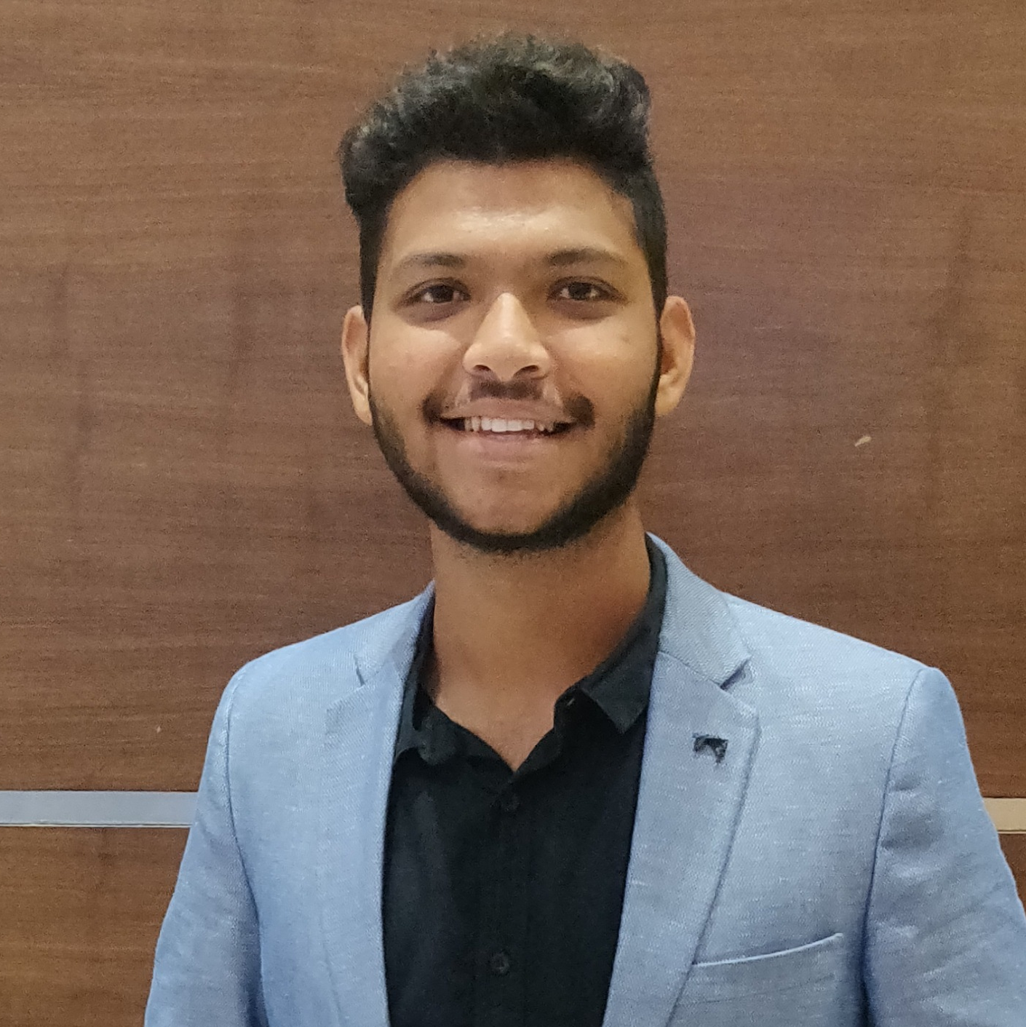

Roles and Responsibilities
RUDRA BARAD
Face Recognition & Web Application
MANAN JOSHI
Face Recognition & Web Application
JUHIE MOTIANI
Backend Developer (PUG, SQLite & NodeJS)

Slide 8
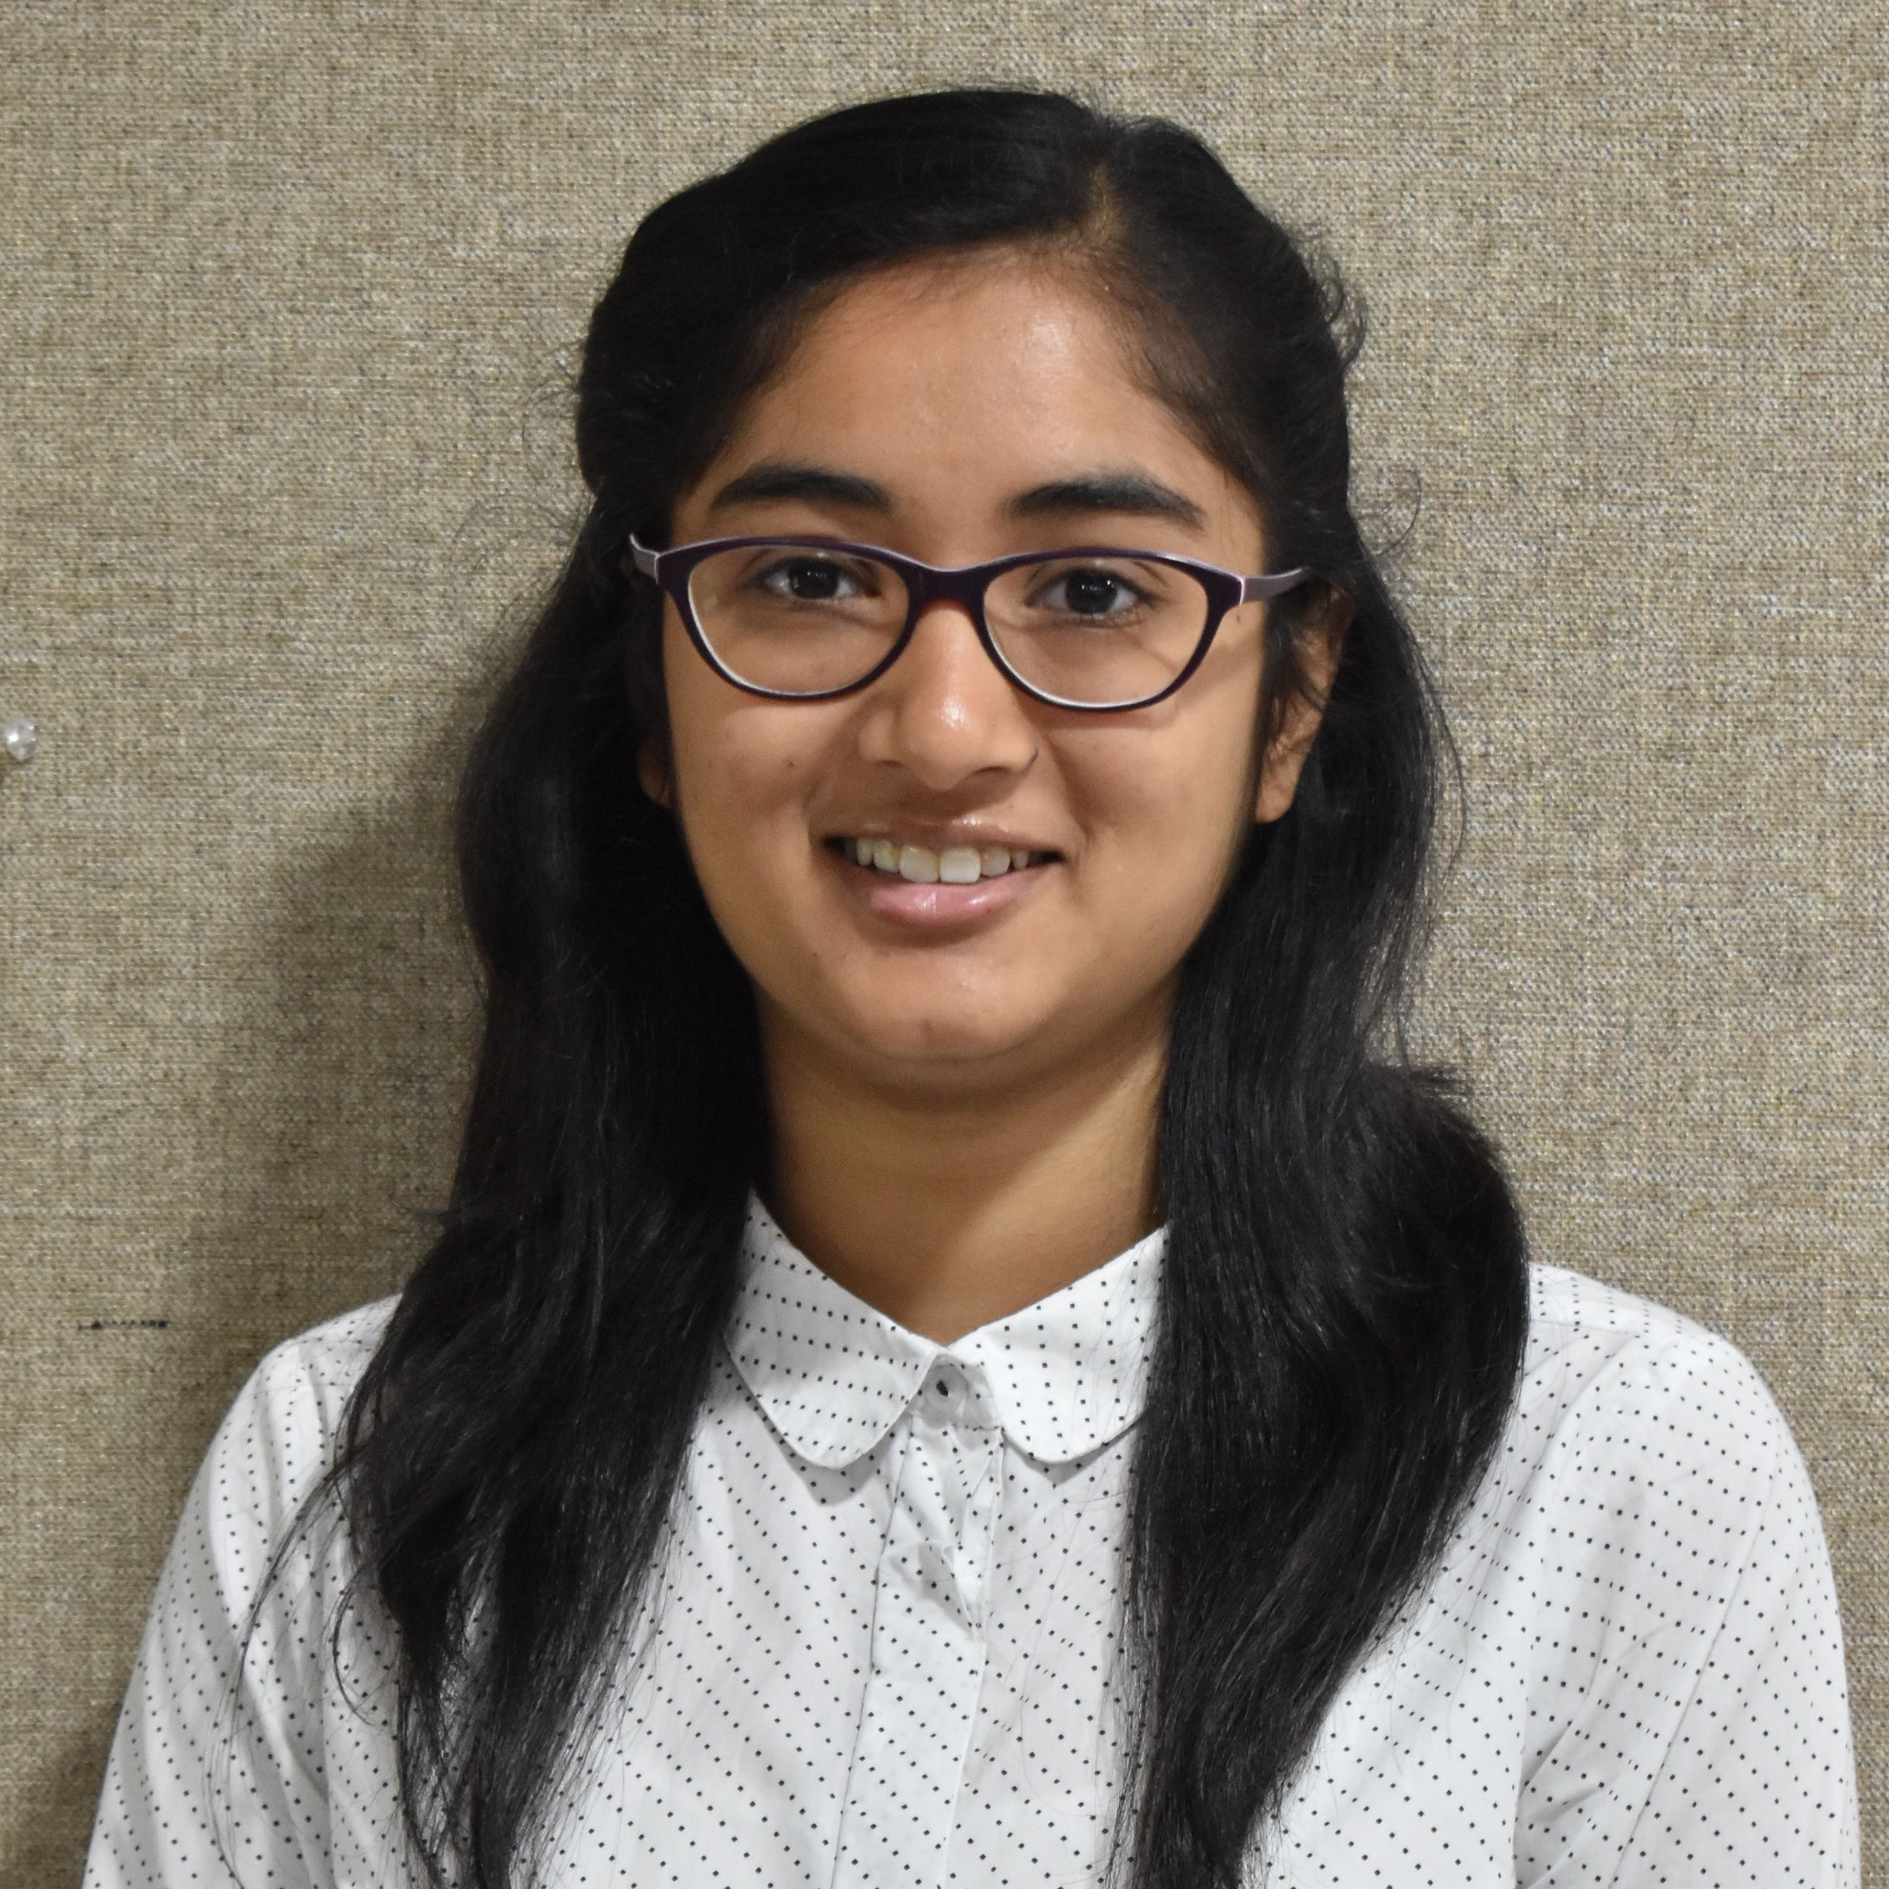
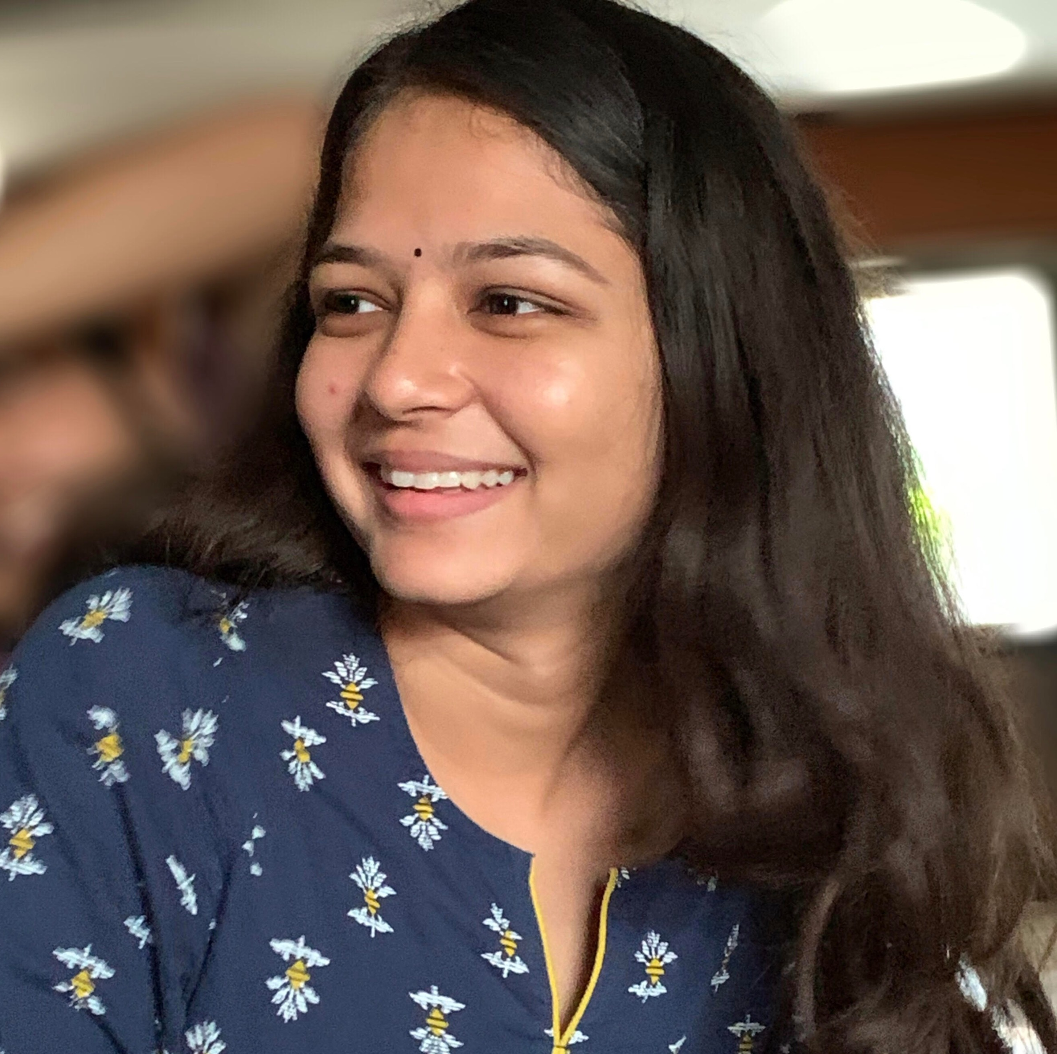

Roles and Responsibilities
ANJALI PATEL
Backend Developer (PUG, SQLite & NodeJS)
DHRUTI PATEL
Age, Gender & Sentiment Analysis
VARUN SHAH
Age, Gender & Sentiment Analysis

Slide 9
Accuracy of Models
90%
75%
85%
Gender Prediction
Age Prediction
Sentimental Analysis
gender_detection.model
age_net.caffemodel
deployage.prototxt

Slide 10
Gantt Chart
Image comparison, Age, Gender, sentiment prediction.
01
Learnt Basics of Python
and OpenCV
02

Slide 11
Gantt Chart
Integrating entire code with Database (SQlite3)
04
Website: Frontend & backend
03

Slide 12
Existing System and Limitations
Costly and requires high maintenance
High configuration software and devices needed
Requires basic understanding of software, hence not completely user friendly
Not completely automated (requires human intervention)

Slide 13
What’s New
No High Configuration required
Multiple Features
User Friendly
System is completely
automatic

Slide 14
Hardware and Software Environment
HARDWARE
Laptop/computer with Core i5 8TH gen. Processor
Webcam
2BG Hard Disk Storage
SOFTWARE
Python Environment
Python Compiler
OpenCV
VS Code
SQLite3
NodeJS (Backend API)
DB Browser

Slide 15
Flowchart
IMAGE CAPTURED
Facial Landmarks
Age Prediction
Sentiments
Gender Prediction
Stored in Database
WEBSITE

Slide 16
Flowchart
IMAGE CAPTURED
Stored in Unknown Folder
Image
Match Found
Image Match
Not Found
Comparison
with Images in Known folder
Display : Match Found
Fetch ID & Increment its
Counter
Discard the Image
Display : Match Not Found
Save image in known
Folder & database
Initialize counter to 1
Update the Database

Slide 17
Flowchart
LOGIN
Authentication
NAVIGATION
Home Page
Services
Data Log
About Developers
Contact Us
Logout

Slide 18
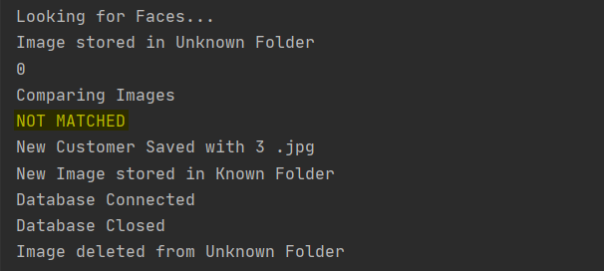
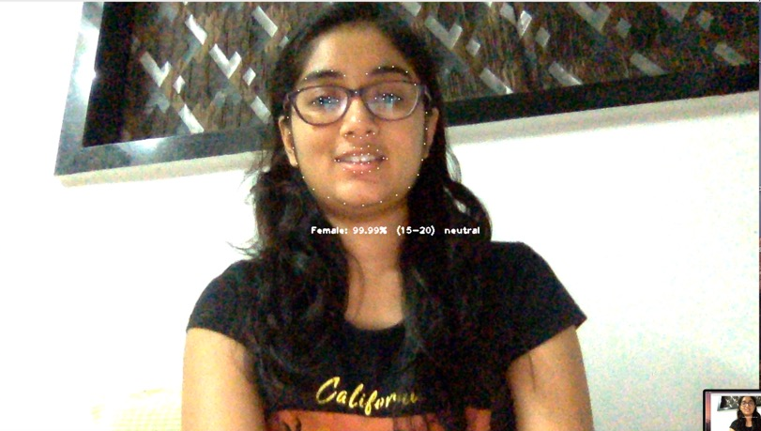
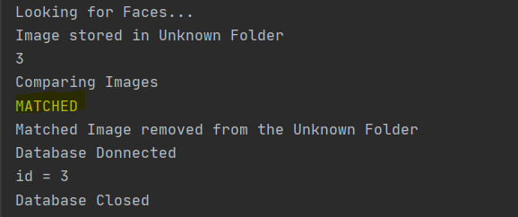
Snapshots

Slide 19
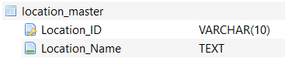
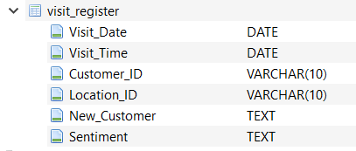
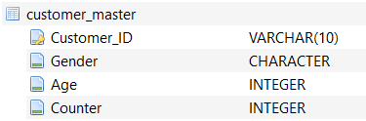
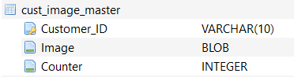
Data Dictionary

Slide 20
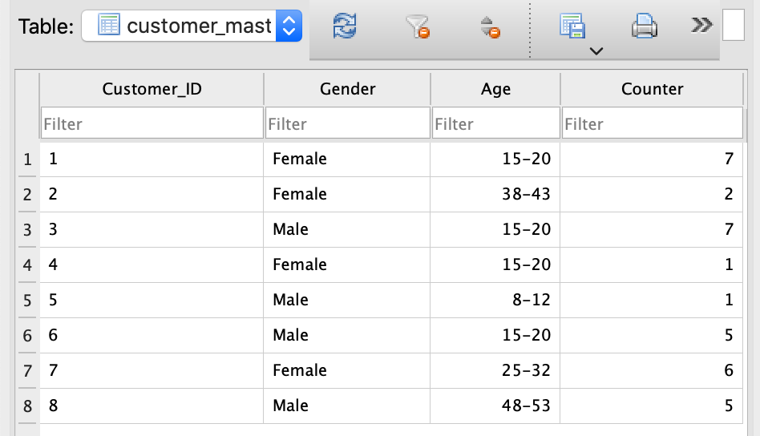
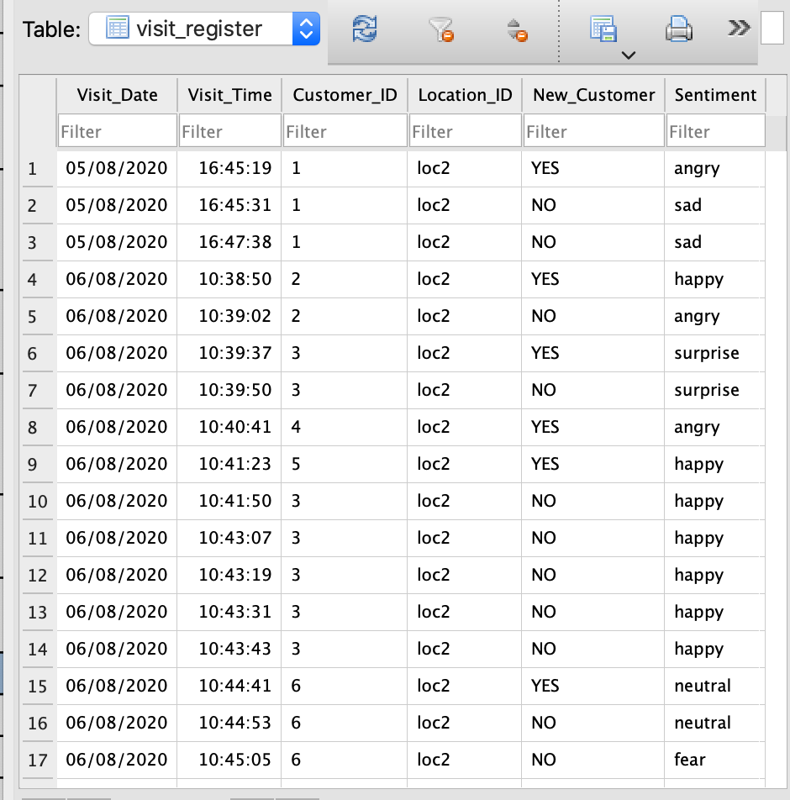
Snapshots

Slide 21
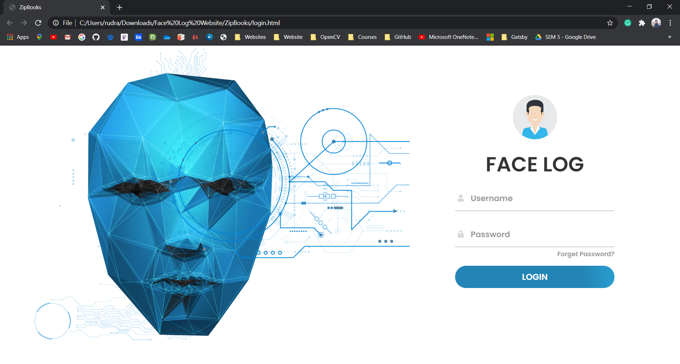
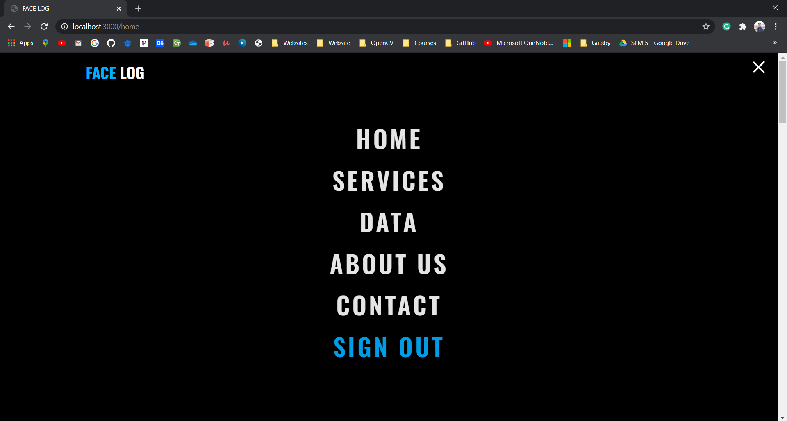
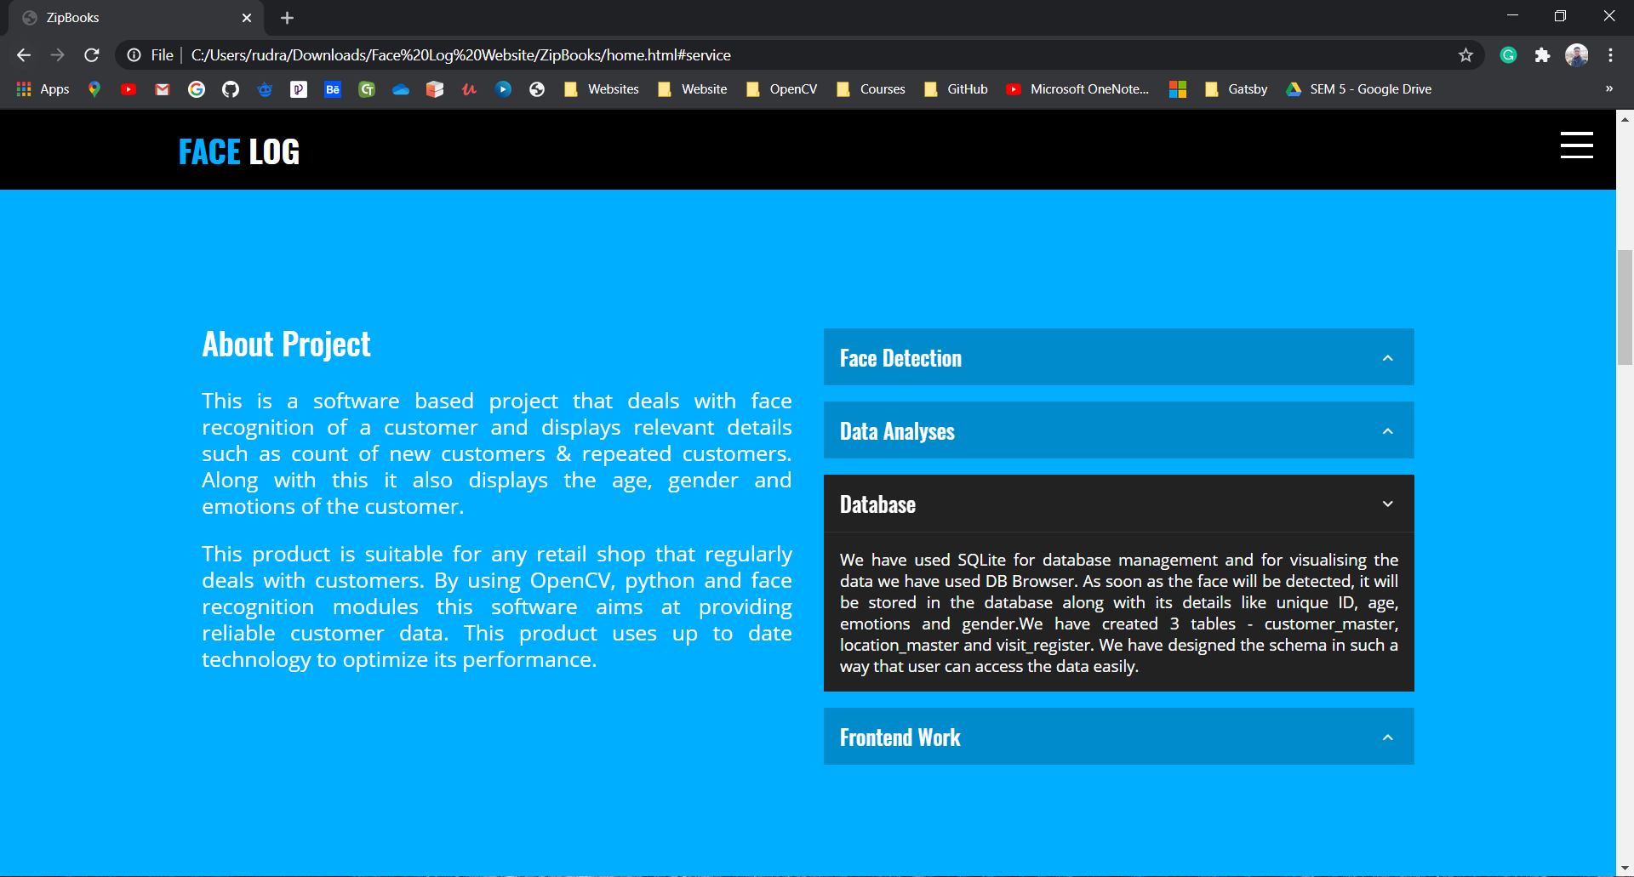
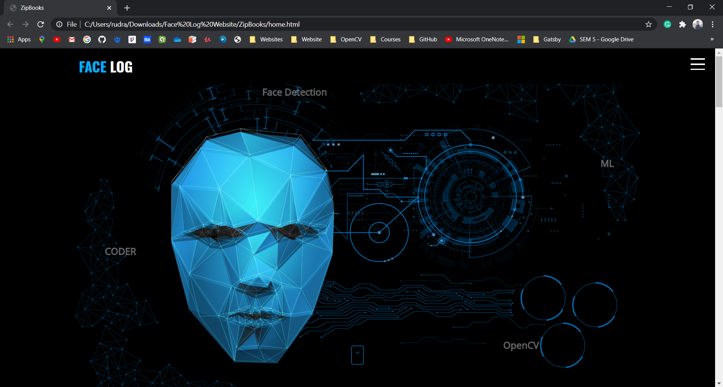
Snapshots of Website

Slide 22
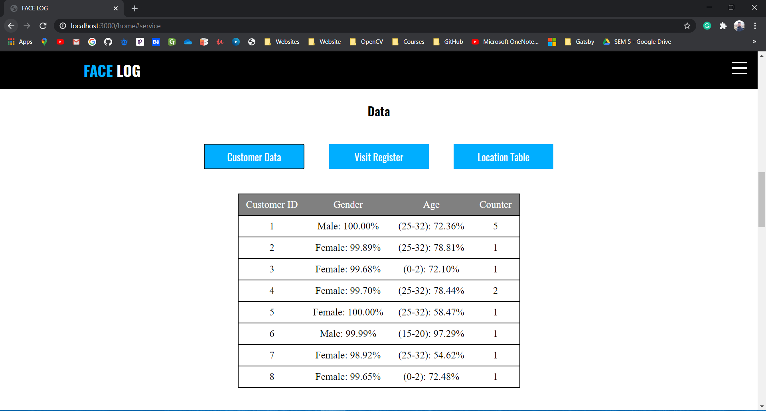
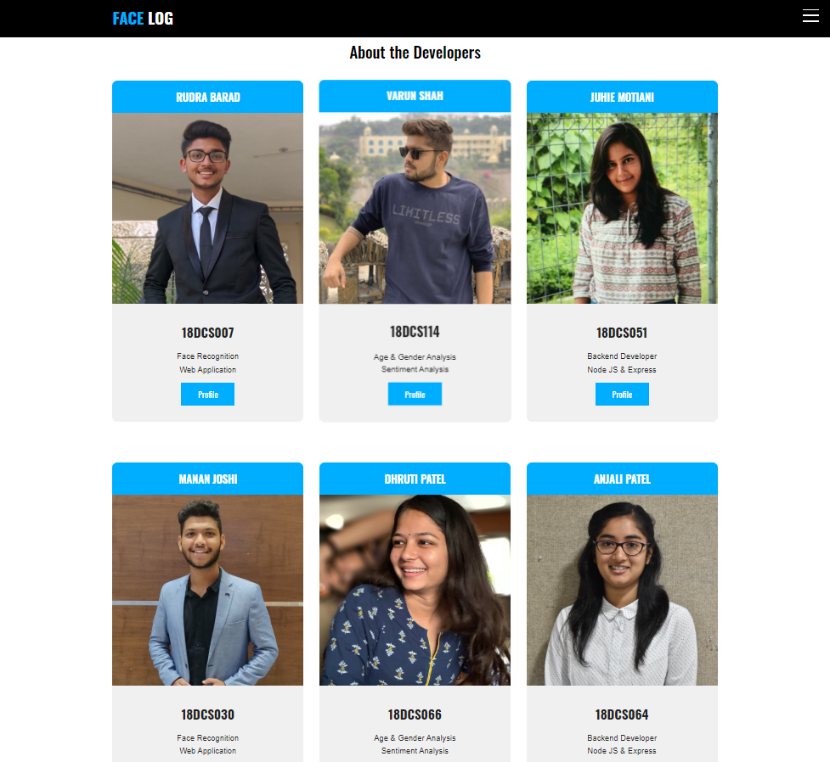
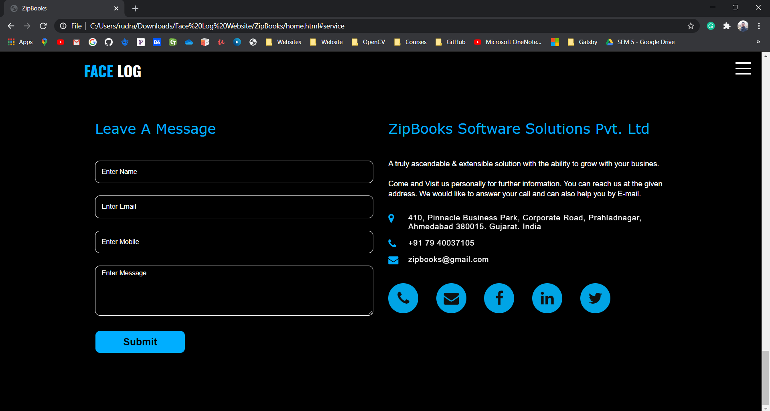
Snapshots of Website

Slide 23
Challenges Faced
Spent almost a week learning new language and get to know about new libraries
It was difficult to download few modules and setup its environment
Unavailability of same functions and commands in windows and mac OS
Updating Dynamic Data on Website
Integrating NodeJS, Express and PUG in Web App without any prior knowledge

Slide 24
Limitations & Future Scope
01
02
Algorithms can be modified to increase its accuracy
All the process could be parallelized and could be done at server side
03
04
Proper positioning of face is required as it also depends on other factors
Total time a person stands in front of the camera should not be more than buffer time of capturing the image

Slide 25
Conclusion
01
Real Time Face Recognition with multiple features
User Friendly System
02
03
One can have statistics about customer’s footfalls and can keep an eye on how their business is working
04
It becomes easier for businessperson to improve their business

Slide 26
References
https://www.python.org/
https://opencv-pythontutroals.readthedocs.io/en/latest/py_tutorials/py_tutorials.html
https://www.jetbrains.com/pycharm/download/#section=windows
https://pypi.org/project/dlib/
https://github.com/ageitgey/face_recognition/issues/440
https://www.tutorialspoint.com/nodejs/index.htm
https://pugjs.org/api/getting-started.html
https://projectsplaza.com/create-dynamic-website-nodejs-mongodb/

Slide 27
THANKYOU

